Slide 1




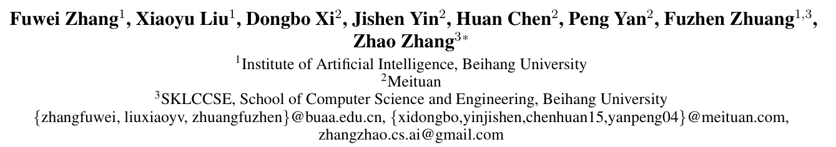



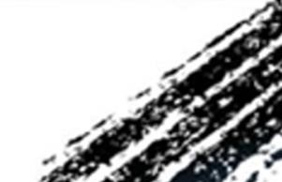

ATAI
Advanced Technique of Artificial Intelligence
ATAI
ChongqingUniversity _{AdvancedTechniqueof}
of Technology Artificial Intelligence
Chongqing University of
Technology
Chongqing University ^{ATAI}
_{of Technology} Advanced Techniqueof
Artificial Intelligence
Chongqing University of Technology
Chongqing University of Technology
Multi-Aspect Cross-modal Quantization for Generative Recommendation
Code : https://github.com/zhangfw123/MACRec
——AAAI_2026
Reported by Yuhang Jang
1

Slide 2
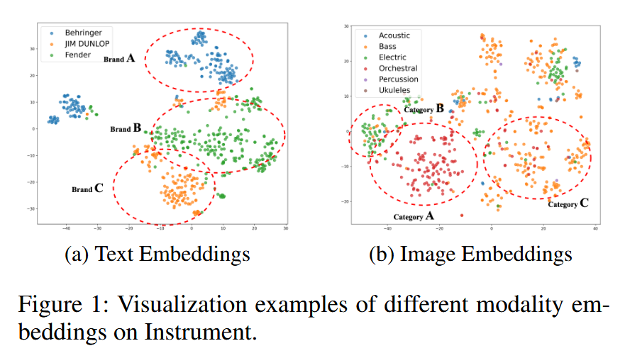
ATAI
Advanced Technique of Artificial Intelligence
ATAI
ChongqingUniversity _{AdvancedTechniqueof}
of Technology Artificial Intelligence
Chongqing University of
Technology
Chongqing University ^{ATAI}
_{of Technology} Advanced Techniqueof
Artificial Intelligence
Chongqing University of Technology
Chongqing University of Technology
Motivation
1) Existing multimodal GR models typically encode each modality separately to obtain semantic IDs for different modalities. They do not consider cross-modal interactions during the quantization process, which makes them more prone to hierarchical semantic loss.

Slide 3
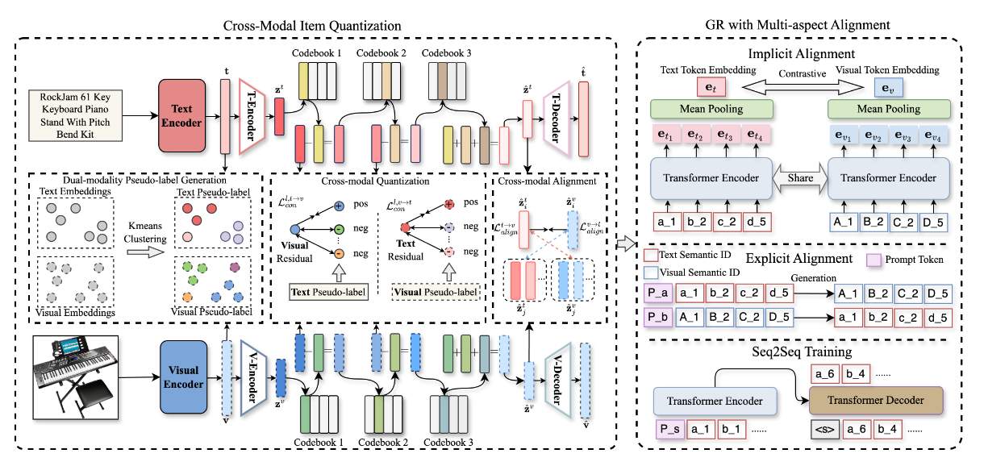
ATAI
Advanced Technique of Artificial Intelligence
ATAI
ChongqingUniversity _{AdvancedTechniqueof}
of Technology Artificial Intelligence
Chongqing University of
Technology
Chongqing University ^{ATAI}
_{of Technology} Advanced Techniqueof
Artificial Intelligence
Chongqing University of Technology
Chongqing University of Technology
Method

Slide 4

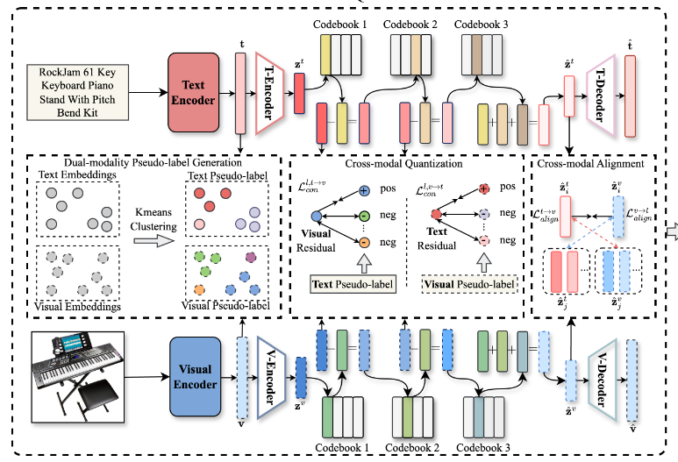
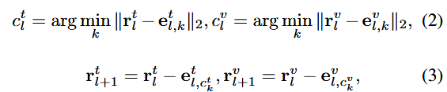
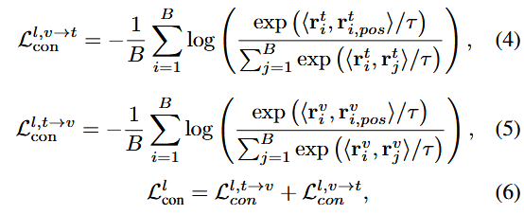
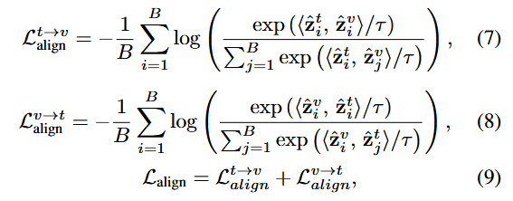
ATAI
Advanced Technique of Artificial Intelligence
ATAI
ChongqingUniversity _{AdvancedTechniqueof}
of Technology Artificial Intelligence
Chongqing University of
Technology
Chongqing University ^{ATAI}
_{of Technology} Advanced Techniqueof
Artificial Intelligence
Chongqing University of Technology
Chongqing University of Technology
Method

Slide 5
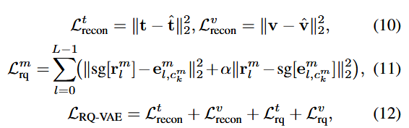

ATAI
Advanced Technique of Artificial Intelligence
ATAI
ChongqingUniversity _{AdvancedTechniqueof}
of Technology Artificial Intelligence
Chongqing University of
Technology
Chongqing University ^{ATAI}
_{of Technology} Advanced Techniqueof
Artificial Intelligence
Chongqing University of Technology
Chongqing University of Technology
Method
Notes:
用子注意力进行融合q为当前模态，k与v为其他模态信息

Slide 6
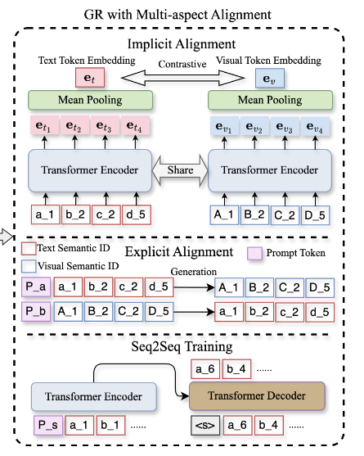
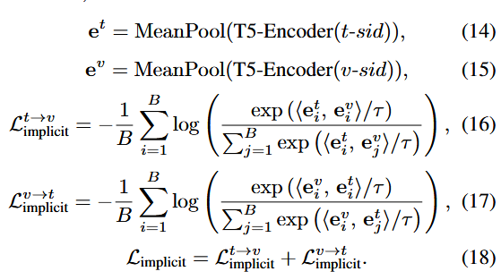
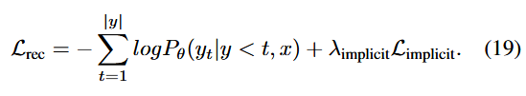
ATAI
Advanced Technique of Artificial Intelligence
ATAI
ChongqingUniversity _{AdvancedTechniqueof}
of Technology Artificial Intelligence
Chongqing University of
Technology
Chongqing University ^{ATAI}
_{of Technology} Advanced Techniqueof
Artificial Intelligence
Chongqing University of Technology
Chongqing University of Technology
Method

Slide 7

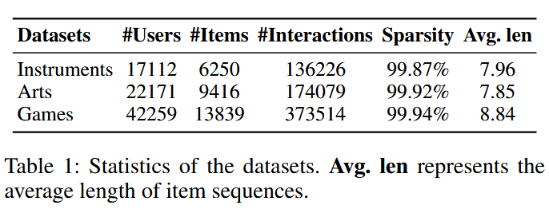
ATAI
Advanced Technique of Artificial Intelligence
ATAI
ChongqingUniversity _{AdvancedTechniqueof}
of Technology Artificial Intelligence
Chongqing University of
Technology
Chongqing University ^{ATAI}
_{of Technology} Advanced Techniqueof
Artificial Intelligence
Chongqing University of Technology
Chongqing University of Technology

Slide 8
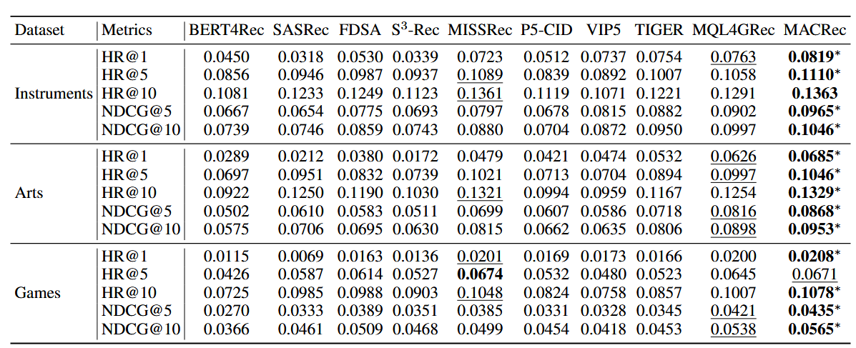
ATAI
Advanced Technique of Artificial Intelligence
ATAI
ChongqingUniversity _{AdvancedTechniqueof}
of Technology Artificial Intelligence
Chongqing University of
Technology
Chongqing University ^{ATAI}
_{of Technology} Advanced Techniqueof
Artificial Intelligence
Chongqing University of Technology
Chongqing University of Technology

Slide 9
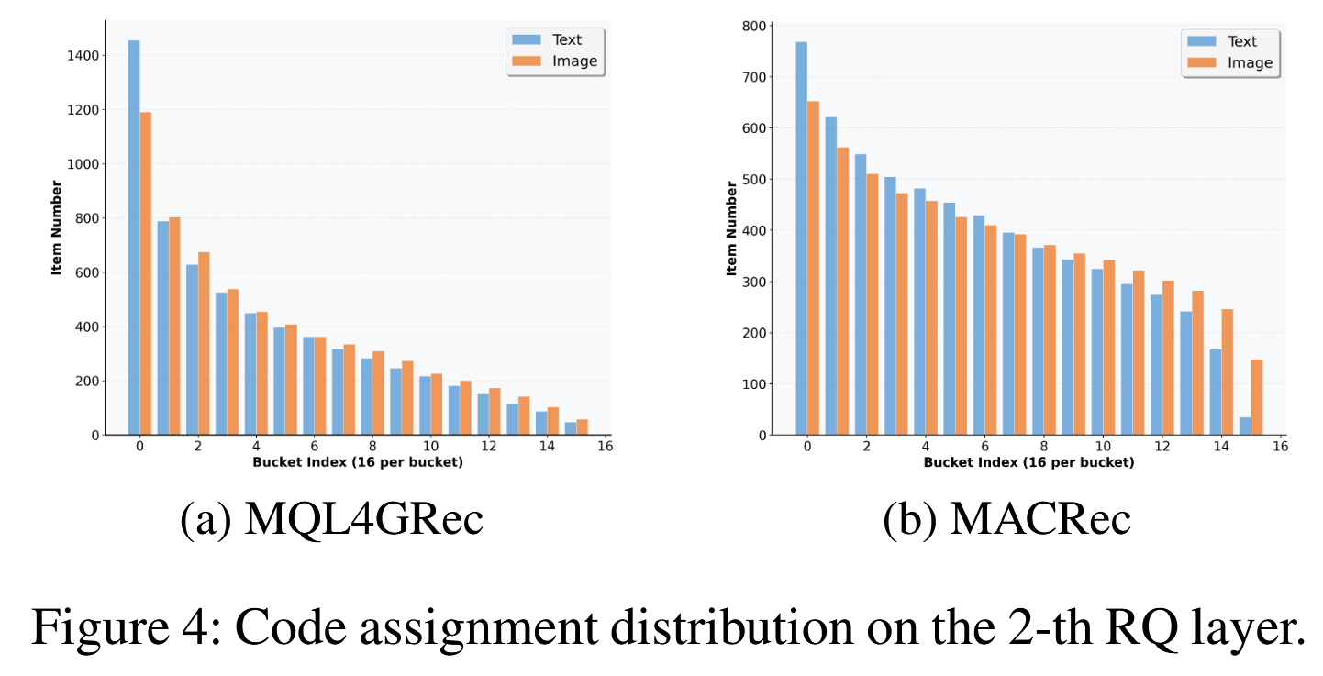
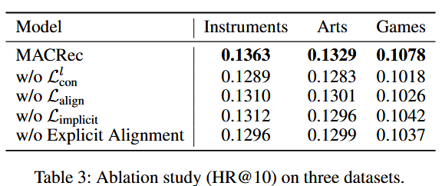
ATAI
Advanced Technique of Artificial Intelligence
ATAI
ChongqingUniversity _{AdvancedTechniqueof}
of Technology Artificial Intelligence
Chongqing University of
Technology
Chongqing University ^{ATAI}
_{of Technology} Advanced Techniqueof
Artificial Intelligence
Chongqing University of Technology
Chongqing University of Technology
Notes:
第一个是再codebook的时候进行跨模态对齐的，第二个是最后进行对齐损失，第三个是用文本模态生成视觉模块的，第四个是进行训练transformer encode。 右边的实验说的是，我拿出第二层，然后将256个每个codebook向量的被选中的数目从大到小排列，然后16个聚合，发现之前的方法会出现长尾效应，但是现在这个方法缓解了长尾效应。

Slide 10
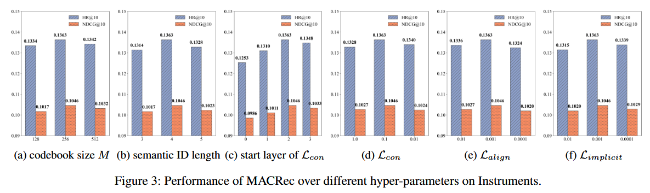
ATAI
Advanced Technique of Artificial Intelligence
ATAI
ChongqingUniversity _{AdvancedTechniqueof}
of Technology Artificial Intelligence
Chongqing University of
Technology
Chongqing University ^{ATAI}
_{of Technology} Advanced Techniqueof
Artificial Intelligence
Chongqing University of Technology
Chongqing University of Technology
Notes:
第三个实验，可以发现当越晚后面会出现信息比较少，使用其他的模态信息补齐可以缓解

Slide 11
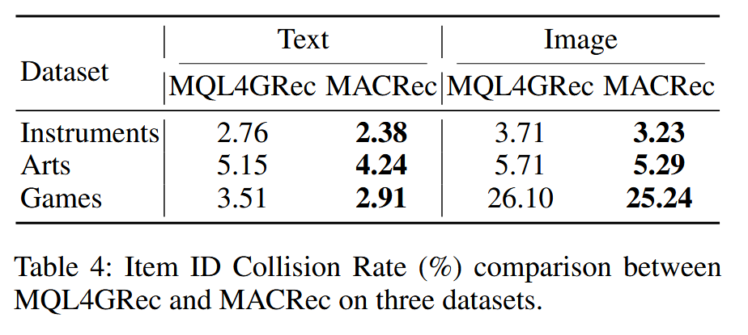
ATAI
Advanced Technique of Artificial Intelligence
ATAI
ChongqingUniversity _{AdvancedTechniqueof}
of Technology Artificial Intelligence
Chongqing University of
Technology
Chongqing University ^{ATAI}
_{of Technology} Advanced Techniqueof
Artificial Intelligence
Chongqing University of Technology
Chongqing University of Technology

Slide 12


ATAI
Advanced Technique of Artificial Intelligence
ATAI
ChongqingUniversity _{AdvancedTechniqueof}
of Technology Artificial Intelligence
Chongqing University of
Technology
Chongqing University ^{ATAI}
_{of Technology} Advanced Techniqueof
Artificial Intelligence
Chongqing University of Technology
Chongqing University of Technology
Thanks!

